Slide 1
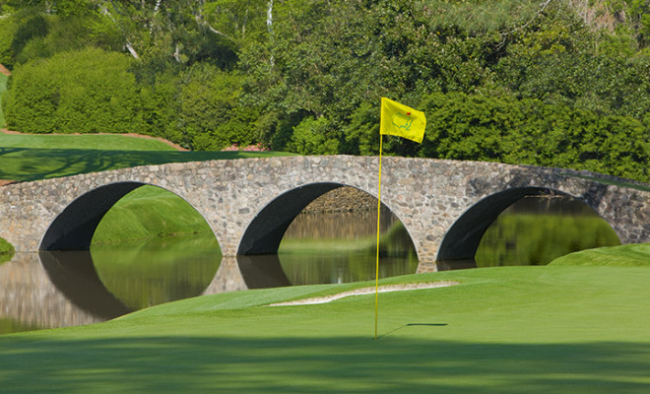
A Good Walk Ruined
An Analysis of Golf Success Measures and Statistics

Slide 2

Outline
Practice Range: Collecting the Data
Front Nine: Traditional Statistics
Back Nine: New Statistics
19th Hole: Time For Fun

Slide 3
Outline
Practice Range: Collecting the Data
Front Nine: Traditional Statistics
Back Nine: New Statistics
19th Hole: Time For Fun

Slide 4
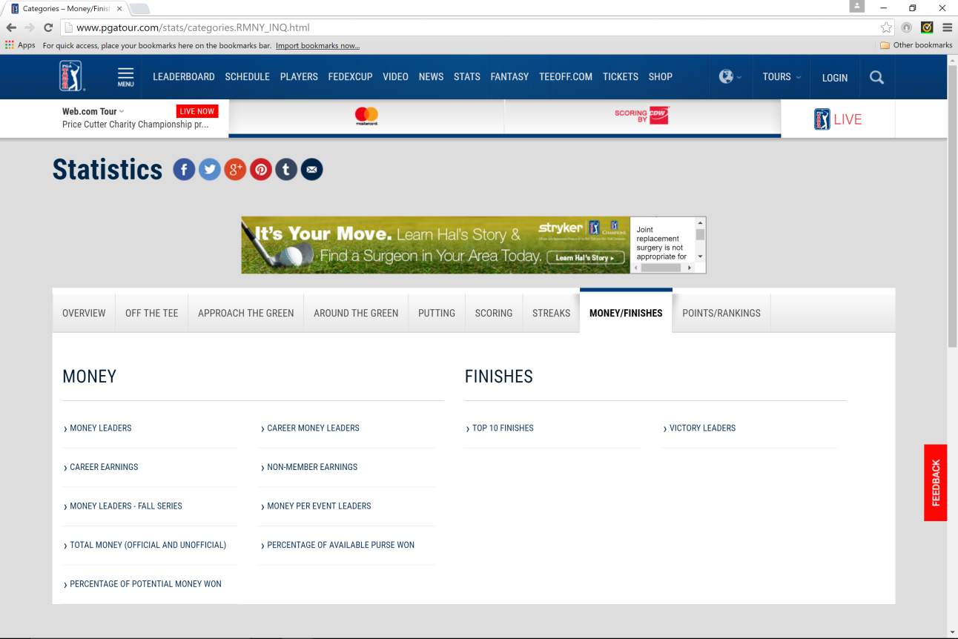
Practice Range: The Data
Data Scraped from www.pgatour.com/stats using Beautiful Soup

Slide 5
Practice Range: Categories
Traditional Performance Statistics:
Off the Tee
Approaching the Green
Around the Green
Putting
New Performance Statistics:
Strokes Gained Off the Tee
Strokes Gained Approaching the Green
Strokes Gained Around the Green
Strokes Gained Putting
Success Metrics:
Money Earned
Fedex Cup Points

Slide 6
Outline
Practice Range: Collecting the Data
Front Nine: Traditional Statistics
Back Nine: New Statistics
19th Hole: Time For Fun

Slide 7
Front Nine: What To Test
First test: Multiple linear regression on traditional statistics
Fedex Cup points on:
drd – Driving Distance
dra – Driving Accuracy
gir – Greens in Regulation
ssv – Sand Saves
scr – Scrambling
pth – Proximity to Hole
pthatg – Proximity to Hole from Around The Green
pmd – Putts Made Distance
ppr – Putts Per Round

Slide 8
Front Nine: Predictive Model
Regress Fedex Cup Points on all* variables
Coefficient* | Estimate | Pr(>|t|) |  | R-Squared: | 0.5062
Intercept | 210.2 | 0.946 |  | Adj R-Sq: | 0.4823
drd | 21.3 | 1.43E-06 |  | p-value: | <2.2E-16
dra | 13.5 | 0.053
gir | 72.5 | 3.54E-06
ssv | 7.5 | 0.133
scr | -14.4 | 0.244
pth | -2.2 | 0.154
pthatg | -16.6 | 2.00E-03
pmd | 25.6 | 0.02
ppr | -332.7 | 6.00E-04
Conclusions
Lots of coefficients with p-values less than .05
Reasonable R-Squared
Perhaps just use highlighted variables

Slide 9
Front Nine: Reduced Model
Regress Fedex Cup Points on reduced variable set
Coefficient* | Estimate | Pr(>|t|) |  | R-Squared: | 0.4831
Intercept | -31.9 | 0.988 |  | Adj R-Sq: | 0.4695
drd | 14.4 | 3.05E-06 |  | p-value: | <2.2E-16
gir | 88.2 | 5.17E-14
pthatg | -16.6 | .000456
ppr | -312.2 | .000150
pmd | -25.9 | .016766
Conclusions
All p-values are small, we can say this model is reasonable
However, VIF is troublesome and we should be wary
Further analysis reveals failure on assumptions
VIF
drd | gir | pthatg | ppr | pmd
1.23 | 1.76 | 1.61 | 2.94 | 1.49

Slide 10
Front Nine: Optimal Model
After Box-Cox Transform and Stepwise Regression
AIC yields: gir + ppr + drd + pthatg + dra + pmd
BIC yields: gir + ppr + drd + pthatg
Choose this for its simplicity and lack of overlap of variables
Coefficient* | Estimate | Pr(>|t|) |  | R-Squared: | 0.5653
Intercept | 51.927 | 6.27E-05 |  | Adj R-Sq: | 0.5562
drd | 0.116 | 1.45E-06 |  | p-value: | <2.2E-16
gir | 0.973 | <2E-16
pthatg | -0.093 | 0.00745
ppr | -4.302 | 4.01E-14
Conclusions
All variables should be included
VIF no longer an issue
Model appears to meet assumptions
R-Squared of 0.5562
VIF
drd | gir | pthatg | ppr
1.21 | 1.69 | 1.43 | 2.02

Slide 11
Outline
Practice Range: Collecting the Data
Front Nine: Traditional Statistics
Back Nine: New Statistics
19th Hole: Time For Fun

Slide 12
Back Nine: Strokes Gained
Strokes Gained: Statistic describing how well a golfer did compared to the “baseline” from a specific distance and lie
Example: Golf player takes shot from 400 yards out in fairway to 100 yards out in the rough
Position | Lie | Baseline Strokes to Hole | Shots
400 | Fairway | 4.05 | 1
100 | Rough | 3.20 | 2 | Strokes Gained
 | Difference | 0.85 | 1 | -0.15

Slide 13
Back Nine: What To Test
Multiple Linear Regression
Fedex Cup points on:
sg_ott – Shots Gained Off the Tee
sg_aptg – Shots Gained Approaching the Green
sg_artg – Shots Gained Around the Green
sg_putt – Shots Gained Putting

Slide 14
Back Nine: SG Optimal Model
After Box-Cox Transform and Stepwise Regression
Optimization reveals that all variables should be used
Coefficient* | Estimate | Pr(>|t|) |  | R-Squared: | 0.7108
Intercept | 15.2045 | <2E-16 |  | Adj R-Sq: | 0.7047
sg_ott | 4.369 | <2E-16 |  | p-value: | <2.2E-16
sg_aptg | 4.117 | <2E-16
sg_artg | 4.579 | 1.97E-10
sg_putt | 4.268 | <2E-16
Conclusions
All variables should be included
Multi-collinearity not an issue
All variables meet assumptions independently
R-Squared of 0.7047
VIF
sg_ott | sg_aptg | sg_artg | sg_putt
1.17 | 1.15 | 1.07 | 1.07

Slide 15
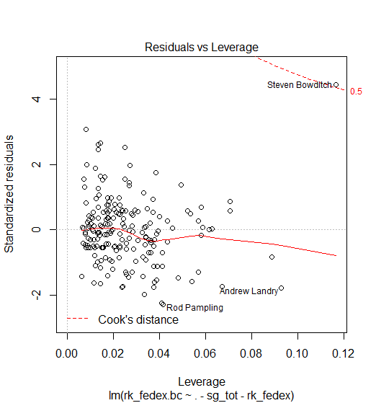
Back Nine: Leverage Issue

Slide 16
Back Nine: Comparing Models
R-Squared: Strokes Gained Model R-Squared of 0.7047 beats Traditional Model R-Squared of 0.5562
AIC/BIC Confirm: AIC and BIC both confirm the Strokes Gained Model is better fit

Slide 17
Outline
Practice Range: Collecting the Data
Front Nine: Traditional Statistics
Back Nine: New Statistics
19th Hole: Time For Fun

Slide 18
19th Hole: Prediction
Can we use model to predict?
- Strokes Gained Issue: Derived statistic, requires knowledge of past performance and accurate measurement
- Strokes Gained Issue: Was not computed before 2002, altered statistic before 2004
- Traditional Model Issue: Not as accurate!

Slide 19
19th Hole: Tiger Woods
How would Tiger of old fare today?
Player | Fedex Cup Rank | Fitted Values
Jason Day | 26.62197 | 24.39598
Dustin Johnson | 26.52216 | 23.84958
Tiger - Upper Conf | 23.36207 | 23.36207
Tiger - Fit | 22.37369 | 22.37369
Phil Mickelson | 22.32562 | 22.23771
Tiger - Lower Conf | 21.38531 | 21.38531
Jordan Spieth | 24.0911 | 21.37981
Rickie Fowler | 20.07347 | 20.93607
Brooks Koepka | 21.46204 | 20.48021
Adam Scott | 24.44998 | 20.21326
Henrik Stenson | 21.65203 | 20.15537
Charl Schwartzel | 20.3012 | 19.66504
Hideki Matsuyama | 21.2478 | 19.4972
Brandt Snedeker | 22.42809 | 19.13311
Matt Kuchar | 21.46696 | 19.10473
Tiger of 2004, using traditional statistics and traditional stats model.
Tiger would have fared well, but would have fallen behind Jason Day and Dustin Johnson

Slide 20
19th Hole: Tiger Woods
Comparing Tiger on Strokes Gained Model
Player | Fedex Cup Rank | Fitted Values
Tiger - Upper Conf | 26.41355 | 26.41355
Tiger - Fitted | 25.37609 | 25.37609
Jason Day | 26.621968 | 24.844669
Tiger - Lower Conf | 24.33862 | 24.33862
Dustin Johnson | 26.522162 | 23.659951
Adam Scott | 24.44998 | 23.413616
Phil Mickelson | 22.32562 | 23.112582
Rory McIlroy | 19.38861 | 22.943232
Jordan Spieth | 24.091096 | 22.910484
Rickie Fowler | 20.07347 | 22.425606
Matt Kuchar | 21.46696 | 21.994139
Brooks Koepka | 21.462038 | 21.544921
Justin Rose | 18.433134 | 21.421732
Charl Schwartzel | 20.301198 | 21.352246
Henrik Stenson | 21.652029 | 21.112395
Tiger of 2004, using Strokes Gained statistics and model
We might have expected Tiger of old to perform well beyond the field.

Slide 21
19th Hole: Ben Townson
How would I fare today?
Player | Fedex Cup Rank | Fitted Values
Jason Day | 26.62197 | 24.39598
Dustin Johnson | 26.52216 | 23.84958
Tiger - Upper Conf | 23.36207 | 23.36207
Tiger - Fit | 22.37369 | 22.37369
Phil Mickelson | 22.32562 | 22.23771
Tiger - Lower Conf | 21.38531 | 21.38531
Jordan Spieth | 24.0911 | 21.37981
Rickie Fowler | 20.07347 | 20.93607
Brooks Koepka | 21.46204 | 20.48021
Adam Scott | 24.44998 | 20.21326
Henrik Stenson | 21.65203 | 20.15537
Charl Schwartzel | 20.3012 | 19.66504
Hideki Matsuyama | 21.2478 | 19.4972
Brandt Snedeker | 22.42809 | 19.13311
Matt Kuchar | 21.46696 | 19.10473
Player | Fedex Cup Rank | Fitted Values
Ben - Upper Conf | -29.16589 | -29.16589
Ben - Fit | -37.7505 | -37.7505
Ben - Lower Conf | -46.33512 | -46.33512

Slide 22
Thanks!

Slide 23
Unless…

Slide 24
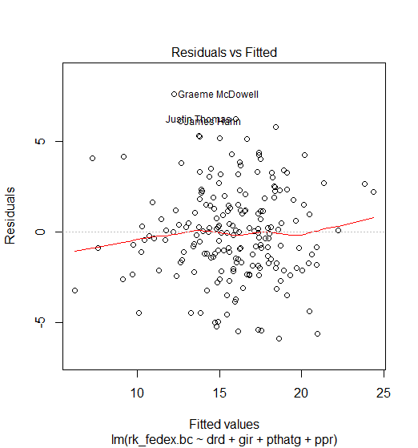
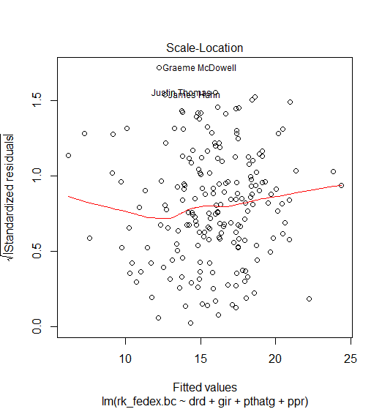
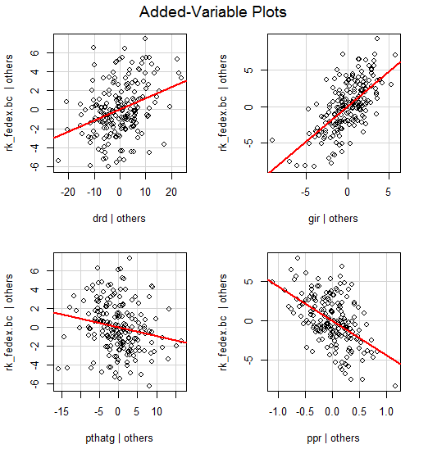
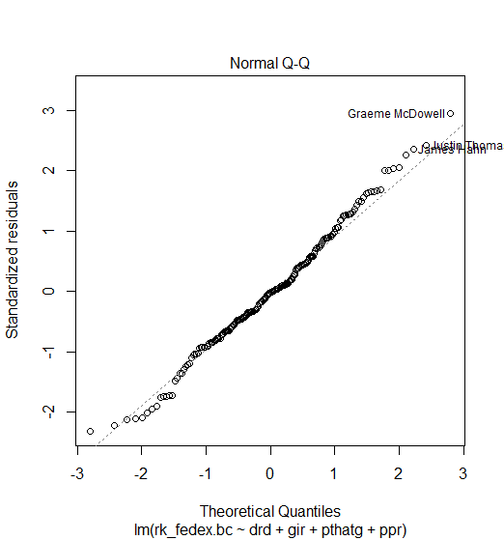
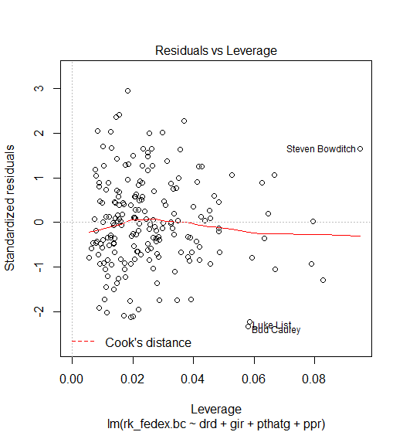
Assumptions Plots – Std Model

Slide 25
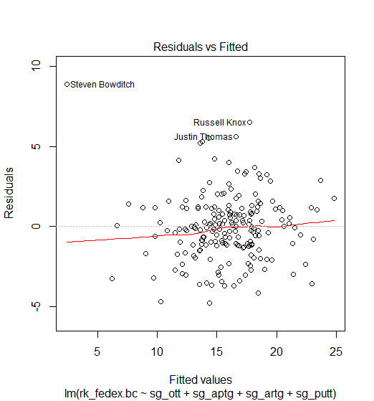
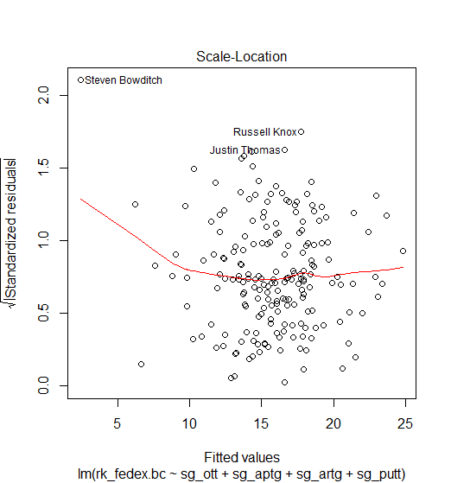
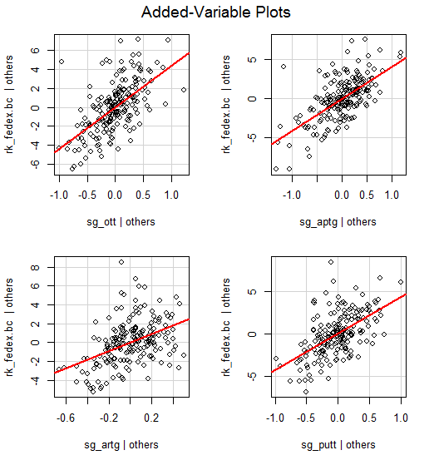
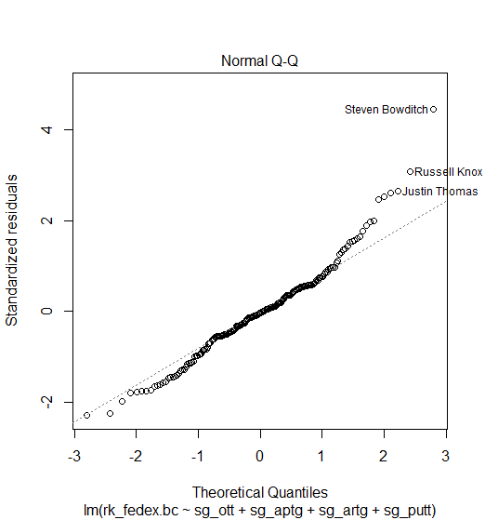
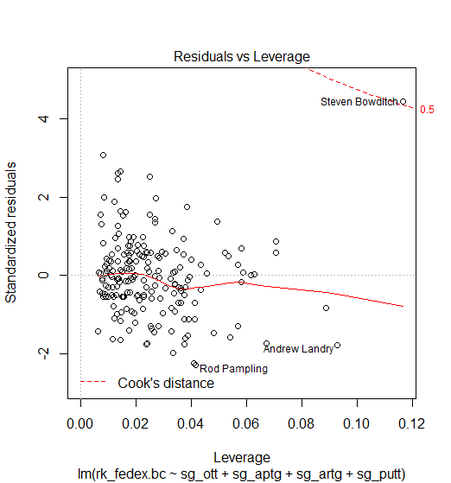
Assumptions Plots – SG Model

